Slide 1
Serves You Right
Project

Slide 2
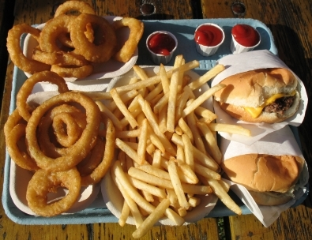
Problem with current school lunches
Processed with an array of chemicals
High fat, carb, & sodium content
Very deficient in providing students with essential nutrients

Slide 3
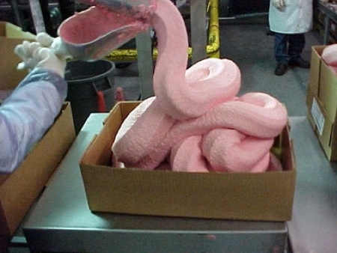
What’s with Chemical Additives ?
Ammonium Hydroxide (aka. Pink slime) is a chemical additive that beef companies use to cure the meat from swarms of pathogens in parts of the cow. This chemical compound known to cause many negative effects on human health including tissue damage on mucous membrane. (Satran, 2012)
Food coloring ( i.e. Red 2,3,40 , Yellow 5,6, and Blue 1,2, etc) are increasingly being proven by many studies to be a major hazard to public health. Negative side effects include cancer, allergies, and hyperactivity (( substitutes for natural food coloring are should be implemented)) (Shapley, 2011)
Benzoate Preservatives ( BHT, BHA, TBHQ) are common chemical compounds used to prevent fats in meat products from becoming rancid, and has been attributed to many detrimental health effects such as hyperactivity, angiodema, asthma, rhinitis, dermatitis, tumors and urticaria.(Shapley, 2011)

Slide 4
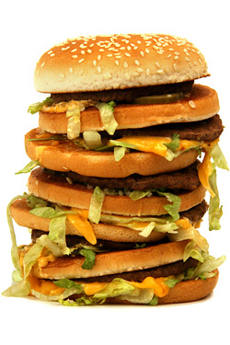
Long Term Effects of a High Fat, Carb, & Sodium Diet
Eating foods with high levels of these contents will lead to an increased risk of heart diseases such as hypertension, high blood pressure, heart attack and stroke (Bramble, 2010)
A early childhood of bad diet habits will eventually lead to a whole array of bad nutritional choices in the rest of their life (Suttle, 2012)
With Obesity rampant in the US, we need to really cut down intake of all of these things to help children cut down extra weight

Slide 5
Results of Nutritional Deficiencies (Suttle, 2012)
Kids may have developmental problems such as Lower learning development and steep decreases in IQ
A lack of meat protein, iron-rich foods or supplements results in anemia. A deficiency of vitamin B12 (folate) also contributes to anemia ((Anemia is a low red blood cell count, which starves the body of oxygen and nutrients. Red blood cells carry oxygen throughout the body and are crucial to a healthy body. ))
A lack of nutrition, such as calcium, can also lead to osteoporosis, which can be harmful later on in the child’s life

Slide 6
Examples of nutrients (Jegtvig, 2012)
Vitamin A is essential for the development of body cells, including the skin and blood.
Vitamin C is needed for production of collagen, which holds cells together.
Vitamin E is essential for healthy red blood cells. Without these fresh foods, the cells, blood and body tissues in a child's body may not develop or function properly.

Slide 7
Why is Subway the best substitute
Lower calorie, saturated fat, and sodium content
Less chemical additives
Packed with more vitamins and antioxidants

Slide 8
Comparison with school lunches
Nutrient | Menu AVG | Nutrients | Menu AVG |  | THE DIFFERENCE
Calories | 784 | Calories | 301.5 |  | 482.5
Cholesterol (mg.) | 77 | Chorlestrol (mg) | 47.375 |  | 29.625
Sodium (mg.) | 1503 | Sodium(mg) | 736.25 |  | 766.75
Fiber (g.) | 8.24 | Fiber(g) | 5 |  | 3.24
Iron(mg) | 4.65 | Iron(mg) | 17.5 |  | 12.85
Calcium(mg) | 504.4 | Calcium(mg) | 30 |  | 474.4
Vitamin A(IU) | 4669 | Vitamin A(IU) | 7544 |  | 2875
Vitamin C(mg) | 39.43 | Vitamin C(mg) | 20 |  | 19.43
Protein(g) | 37.35 | Protein(g) | 19.75 |  | 17.6
Carbohydrate(g) | 102.12 | Carbohydrate(g) | 47.375 |  | 54.82
Total Fat (g) | 26.12 | Total Fat (g) | 4.1875 |  | 21.9325
Saturated Fat (g) | 7.16 | Saturated Fat (g) | 1.125 |  | 6.035
(School Nutrition and Fitness, 2012) (Subways, 2012)

Slide 9
How does a combination of low fat/carb diet help (The Nutrition Source, 2012)
Improvements in waist circumference, blood pressure, triglycerides (blood fats), fasting blood sugar, C-reactive protein (a factor of heart disease), and an increase in HDL cholesterol (high density lipoprotein, or “good” cholesterol)
Low carb diets burn more calories than low fat diet.
Reduced blood glucose (sugar) in diabetics and pre diabetics, and lower blood insulin level.
Increase in energy, fewer cravings for sweets, better mental concentration, improved moods, loss of compulsive eating, and improved dental hygiene.

Slide 10
What can we expect from this program?
Healthier alternatives in school cafeteria lunches
Students will feel more energized throughout the day
Students can lose weight and take in a step toward a healthy lifestyle
Students will pay more attention in school and put effort into their work (Blackwell, 2008)

Slide 11
SOURCES
Suttle, Rick. "What Happens If Children Lack Fresh Fruits & Vegetables?" What Happens If Children Lack Fresh Fruits & Vegetables? Http://www.livestrong.com/article/554287-what-happens-if-children-lack-fresh-fruits-vegetables/#ixzz2BIu6fwew (2012): n. pag. LIVESTRONG.COM. Web. 29 Oct. 2012. <http://www.livestrong.com/article/554287-what-happens-if-children-lack-fresh-fruits- vegetables/>.
Shapley, Dan. "The Case Against Artificial Food Colorings: Should You Be Concerned?" The Daily Green. Hearst Communications, Inc., 1 Apr. 2011. Web. 29 Oct. 2012. <http://www.thedailygreen.com/healthy-eating/eat-safe/artificial-food-colorings-health-effects>.
Satran, Joe. "Pink Slime, Ammonium Hydroxide Fast Food Ground Beef Additive, Dropped By McDonald's Et Al." The Huffington Post. TheHuffingtonPost.com, 27 Jan. 2012. Web. 27 Oct. 2012. <http://www.huffingtonpost.com/2012/01/27/pink-slime-fast- food_n_1237206.html%20>.
Blackwell Publishing Ltd.. "Children With Healthier Diets Do Better In School, Study Suggests." ScienceDaily, 22 Mar. 2008. Web. 4 Nov. 2012
Bramble, Laura. "Health Problems Caused by Poor Nutrition." EHow. Demand Media, 24 May 2010. Web. 04 Nov. 2012. <http://www.ehow.com/list_6545089_health-problems-caused-poor-nutrition.html>.
Grass, Johnathan. "Subway Becomes Part of Local High School Lunches." Juneau Empire. Juneau Empire, 26 Apr. 2011. Web. 04 Nov. 2012. <http://juneauempire.com/local/2011-04-26/subway-becomes-part-local-high-school-lunches>.
"The Nutrition Source." Harvard School of Public Health. N.p., n.d. Web. 04 Nov. 2012. <http://www.hsph.harvard.edu/nutritionsource/healthy-weight/healthy-weight-full-story/>.
Jegtvig, Shereen. "What Is Nutrition?" About.com Nutrition. About.com., 29 Oct. 2012. Web. 27 Oct. 2012. <http://nutrition.about.com/od/nutrition101/a/why_nutrition.htm>.
"School Nutrition and Fitness." School Nutrition and Fitness. Alhambra Unified School District, 20 Aug. 2012. Web. 25 Oct. 2012. <http://www.schoolnutritionandfitness.com/index.php?page=menus>.
"Nutrition Information List | SUBWAY.com." Nutrition Information List | SUBWAY.com. Subways, 16 Jan. 2008. Web. 04 Nov. 2012. <http://www.subway.com/nutrition/nutritionlist.aspx>.

